Slide 1
Summary Queries with Aggregate FUNCTIONS
Chapter 6

Slide 2
Aggregate Functions
COUNT(expr) - returns a count of the number of non-null values of expr in the rows retrieved by a SELECT statement. Returns 0 if no matching rows.
COUNT(*) – returns a count of the number of rows retrieved, whether or not they contain null values. Returns 0 if no matching rows.
SUM( ) – returns the sum of expr. If the return set has no rows, a null is returned.
AVG( ) – returns the average value of expr. Returns null if no matching rows.
MAX( ) – returns the maximum value of expr. Returns null if no matching rows.
MIN( ) – returns the minimum value of expr. Returns mull if not matching rows.
The distinct keyword can be used to include only the distinct values.

Slide 3
Summary / Aggregate - Functions
GROUP BY
HAVING
WHERE
WITH ROLLUP

Slide 4
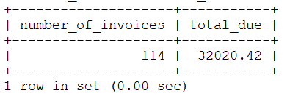
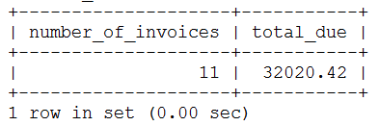
COUNT and SUM
What is the total number of invoices and the total amount due for all invoices?
SELECT COUNT(*) AS number_of_invoices,
SUM(invoice_total – payment_total – credit_total) AS total_due
FROM invoices;
What is the total number of invoices and the total amount due for all invoices with a total due?
SELECT COUNT(*) AS number_of_invoices,
SUM(invoice_total – payment_total – credit_total) AS total_due
FROM invoices
WHERE invoice_total – payment_total – credit_total > 0;

Slide 5
COUNT, SUM, & AVG
What is the total number of invoices, the average invoice amount, and the total amount due for invoices after 01-01-2018?
STEP1 : start with original query
SELECT COUNT(*) AS number_of_invoices,
SUM(invoice_total – payment_total – credit_total) AS total_due
FROM invoices
WHERE invoice_total – payment_total – credit_total > 0;

Slide 6
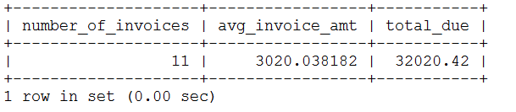
COUNT, SUM, & AVG
What is the total number of invoices, the average invoice amount, and the total amount due for invoices after 01-01-2018?
STEP2 : add the AVG function
SELECT COUNT(*) AS number_of_invoices,
AVG(invoice_total) AS avg_invoice_amt,
SUM(invoice_total – payment_total – credit_total) AS total_due
FROM invoices
WHERE invoice_total – payment_total – credit_total > 0;

Slide 7
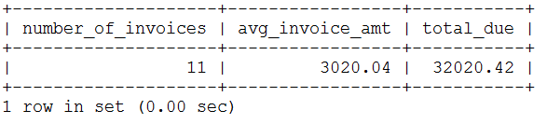
COUNT, SUM, & AVG
What is the total number of invoices, the average invoice amount, and the total amount due for invoices after 01-01-2018?
STEP3 : add the ROUND function
SELECT COUNT(*) AS number_of_invoices,
ROUND(AVG(invoice_total), 2) AS avg_invoice_amt,
SUM(invoice_total – payment_total – credit_total) AS total_due
FROM invoices
WHERE invoice_total – payment_total – credit_total > 0;

Slide 8
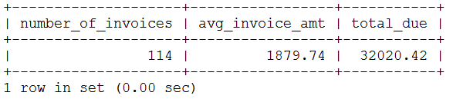
COUNT, SUM, & AVG
What is the total number of invoices, the average invoice amount, and the total amount due for invoices after 01-01-2018?
STEP4 : change the criteria
SELECT COUNT(*) AS number_of_invoices,
ROUND(AVG(invoice_total), 2) AS avg_invoice_amt,
SUM(invoice_total – payment_total – credit_total) AS total_due
FROM invoices
WHERE invoice_date > ‘2018-01-01’;

Slide 9
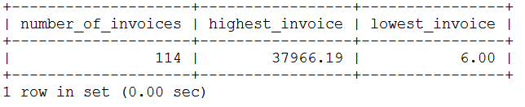
MIN & MAX
What is the highest and lowest invoice since 01-01-2018?
SELECT COUNT(*) AS number_of_invoices,
MAX(invoice_total) as highest_invoice,
MIN(invoice_total) as lowest_invoice
FROM invoices
WHERE invoice_date > ‘2018-01-01’;

Slide 10
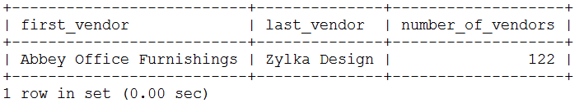
Non Numeric Columns
How many vendors are there and which one is first alphabetically and which one is last alphabetically?
SELECT MIN(vendor_name) AS first_vendor,
MAX(vendor_name) AS last_vendor,
COUNT(vendor_name) AS number_of_vendors
FROM vendors;

Slide 11
GROUP BY and HAVING
SELECT select_list
FROM table
[WHERE search condition]
[GROUP BY group_by_list]
[HAVING search condition]
[ORDER BY order_by_list]

Slide 12
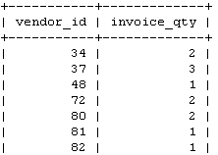
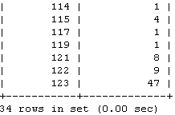
GROUP BY and HAVING
Count the number of invoices by vendor.
SELECT vendor_id, COUNT(*) AS invoice_qty
FROM invoices
GROUP BY vendor_id;

Slide 13
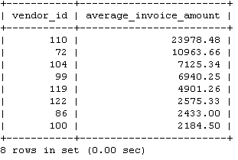
GROUP BY and HAVING
List the average invoice amount per vendor for vendors where the average invoice total is greater than 2000.
SELECT vendor_id, ROUND(AVG(invoice_total), 2) AS average_invoice_amount
FROM invoices
GROUP BY vendor_id
HAVING AVG(invoice_total) > 2000
ORDER BY average_invoice_amount DESC;

Slide 14
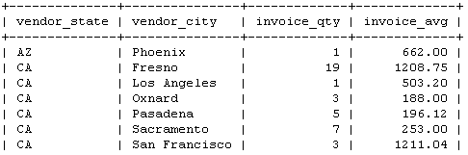
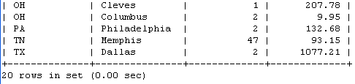
Aggregate with JOIN
List the number of invoices and the average invoice amount by city, state.
SELECT vendor_state, vendor_city, COUNT(*) AS number_invoices,
ROUND(AVG(invoice_total), 2) AS invoice_avg_amount
FROM invoices JOIN vendors
ON invoices.vendor_id = vendors.vendor_id
GROUP BY vendor_state, vendor_city;
FROM invoices i JOIN vendors v
ON i.vendor_id = v.vendor_id
FROM invoices i, vendors v
WHERE i.vendor_id = v.vendor_id
FROM invoices NATURAL JOIN vendors
FROM invoices JOIN vendors
USING(vendor_id)

Slide 15
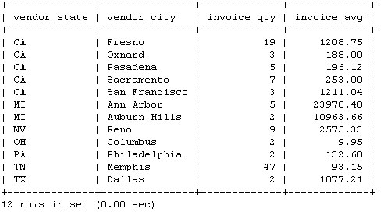
Aggregate with JOIN
List the number of invoices and the average invoice amount by city, state.
Limit to groups with two or more invoices.
SELECT vendor_state, vendor_city, COUNT(*) AS invoice_qty,
ROUND(AVG(invoice_total), 2) AS invoice_avg
FROM invoices JOIN vendors
ON invoices.vendor_id = vendors.vendor_id
GROUP BY vendor_state, vendor_city
HAVING COUNT(*) >= 2;

Slide 16
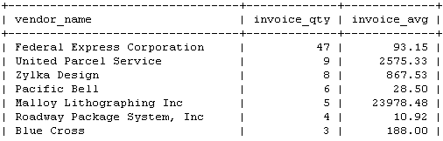

Aggregate with JOIN
List the number of invoices and the average invoice amount by vendor.
SELECT vendor_name, COUNT(*) AS invoice_qty,
ROUND(AVG(invoice_total),2) AS invoice_avg
FROM vendors JOIN invoices
ON vendors.vendor_id = invoices.vendor_id
GROUP BY vendor_name
ORDER BY invoice_qty DESC;

Slide 17
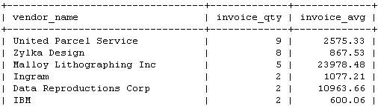

Aggregate with JOIN
List the number of invoices and the average invoice amount by vendor.
Show only those with average invoice totals > 500.
SELECT vendor_name, COUNT(*) AS invoice_qty,
ROUND(AVG(invoice_total),2) AS invoice_avg
FROM vendors JOIN invoices
ON vendors.vendor_id = invoices.vendor_id
GROUP BY vendor_name
HAVING AVG(invoice_total) > 500
ORDER BY invoice_qty DESC;

Slide 18
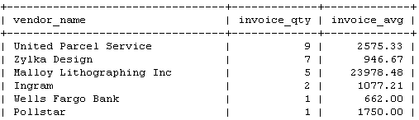

Aggregate with JOIN
List the number of invoices and the average invoice amount by vendor.
Show only those with invoice totals > 500.
SELECT vendor_name, COUNT(*) AS invoice_qty,
ROUND(AVG(invoice_total),2) AS invoice_avg
FROM vendors JOIN invoices
ON vendors.vendor_id = invoices.vendor_id
WHERE invoice_total > 500
GROUP BY vendor_name
HAVING AVG(invoice_total) > 500
ORDER BY invoice_qty DESC;

Slide 19
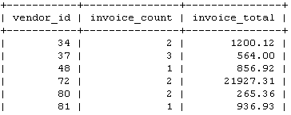

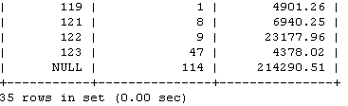
ROLLUP – summary row
SELECT vendor_id, COUNT(*) AS invoice_count,
SUM(invoice_total) AS invoice_total
FROM invoices
GROUP BY vendor_id;
SELECT vendor_id, COUNT(*) AS invoice_count,
SUM(invoice_total) AS invoice_total
FROM invoices
GROUP BY vendor_id WITH ROLLUP;

Slide 20
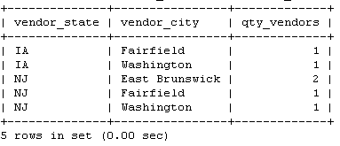
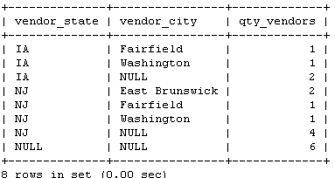
ROLLUP – summary row by group
SELECT vendor_state, vendor_city, COUNT(*) AS qty_vendors
FROM vendors
WHERE vendor_state IN ('IA', 'NJ')
GROUP BY vendor_state ASC, vendor_city ASC;
SELECT vendor_state, vendor_city, COUNT(*) AS qty_vendors
FROM vendors
WHERE vendor_state IN ('IA', 'NJ')
GROUP BY vendor_state ASC, vendor_city ASC WITH ROLLUP;

